Slide 1

Workshop on “ Neurons to Networks: Unleashing the Power of Brain-Inspired AI”
Brain Research with Artificial Intelligence
A Computational Approach to Understanding the Brain from biological neuron to network
Dr. Asha Vijayan
Assistant Professor (Sl. Gr)
Mind Brain Center
Amrita University
ashavijayan@am.amrita.edu
14-03-2025

Slide 2
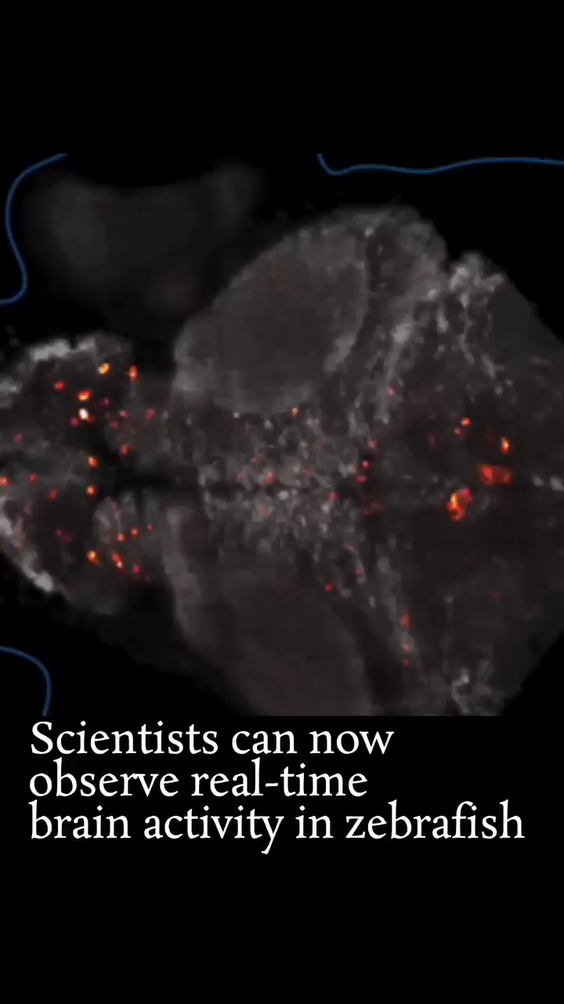
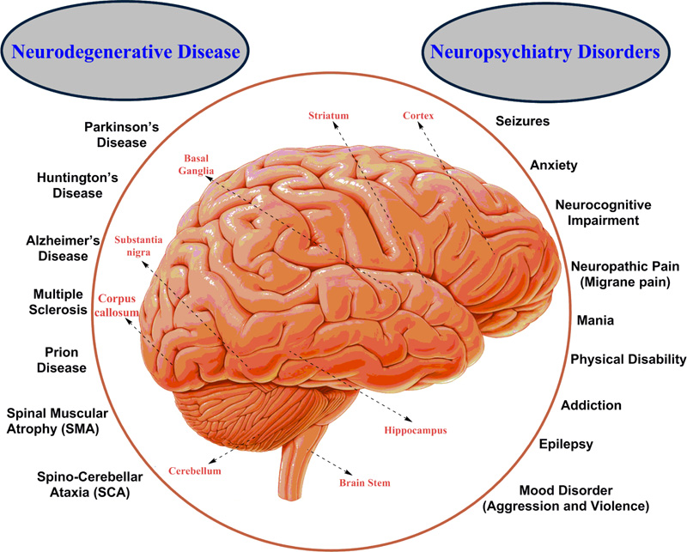
Why Brain Research is Important?
Understanding Human
High level Information Processing
Neuropsychatric Conditions
Treatments
Neurological Disorders
Diagnostic Techniques
https://www.linkedin.com/posts/drrvs_brain-neuronal-zebrafish-activity-7303470486699528195-_7Br?utm_source=share&utm_medium=member_desktop&rcm=ACoAAAzzB7QBKIgLdvgFKA-HfmfuRLwRMrYUq1o
Notes:
Ca imaging and Light sheet microscopy

Slide 3
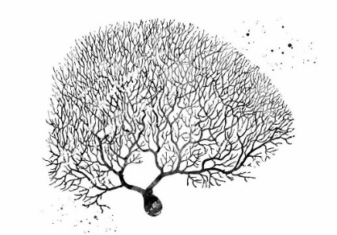

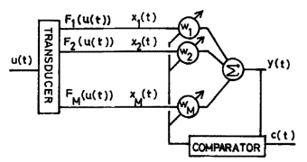
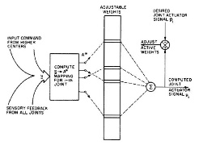
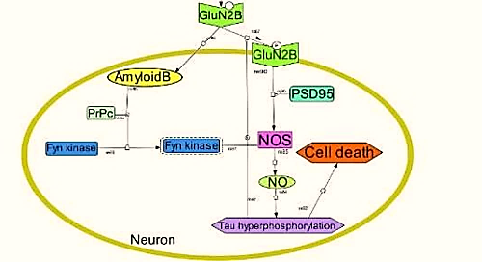
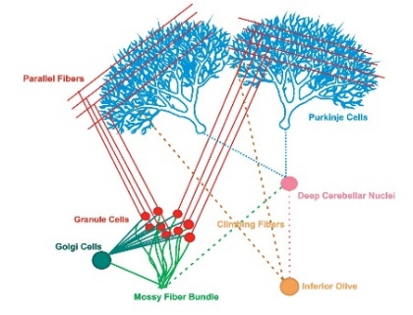
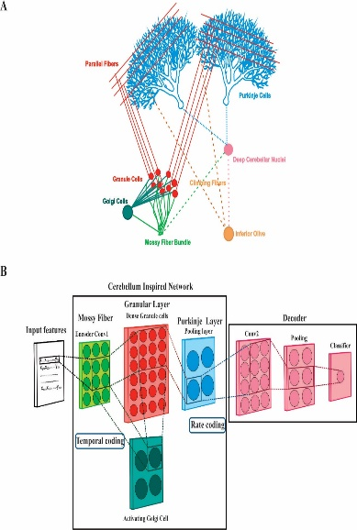
Driving Force in Brain Research
Data
Model
Theories
Motor adaptation theory
Reflex theory
Theory of parallel distributed processing
Activity Oriented Theory
Systems Theory
Hierarchical theory
Notes:
Come up with theories and with the help of data and mode

Slide 4
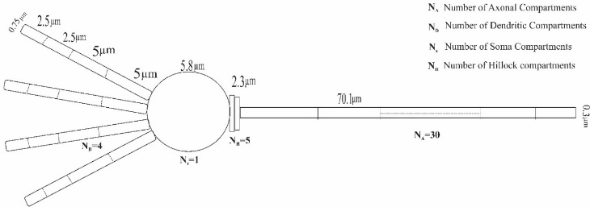
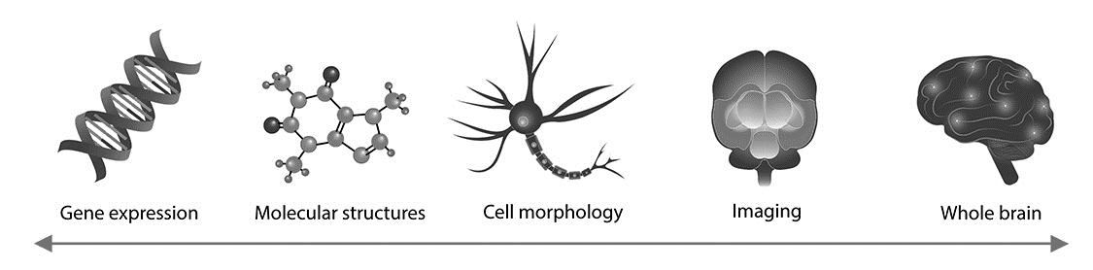
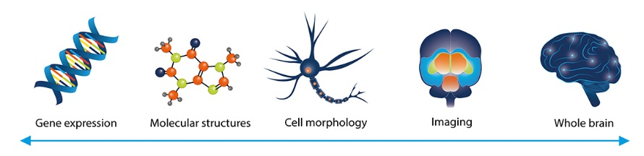

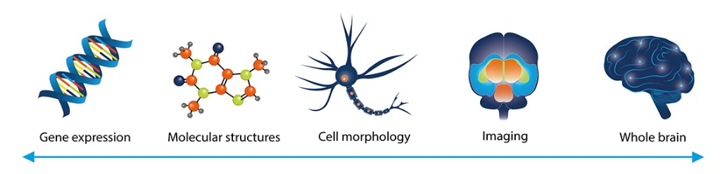

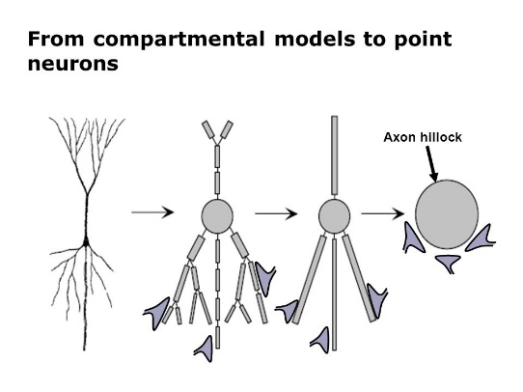

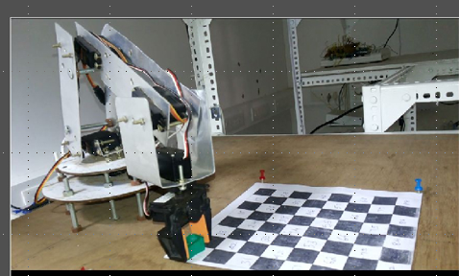
Modeling Approach
Realistic model
Robotic model
Hypothesis
Biological Data
Theoretical Model

Slide 5
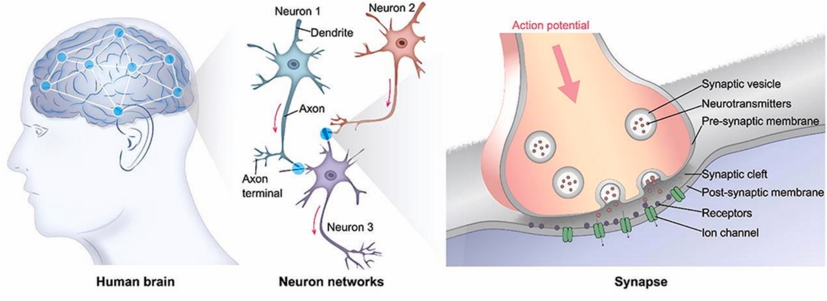
Neuroscience in a nutshell
Neurons
Genes, Proteins, Neurotransmitter
Biomarkers
Networks
Single neurons
Interconnected circuits
Population of neurons
Pathways
Connections to other brain regions
Diseases
Oscillations
Synapses
Neurodegenerative
Neuropsychatric
1. Tanvir Ahmed, Bio-inspired artificial synapses: Neuromorphic computing chip engineering with soft biomaterials, Memories - Materials, Devices, Circuits and Systems, Volume 6, 2023, 100088,
2. https://nsvl-au.vlabs.ac.in/exp/modeling-action-potentials/theory.html
Notes:
Brain structure: neurons, synapses, networks
How the brain processes information
Overview of cognitive functions (learning, memory, decision-making)
Neuroscience data types: EEG, fMRI, MEG, Single-cell recordings

Slide 6
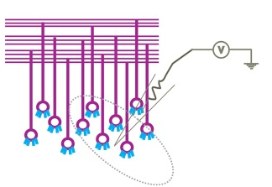
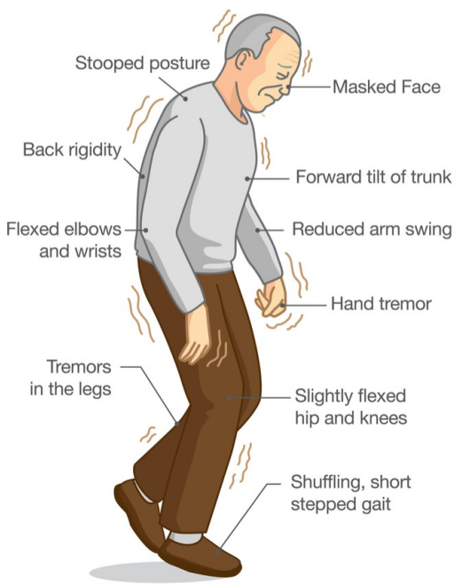
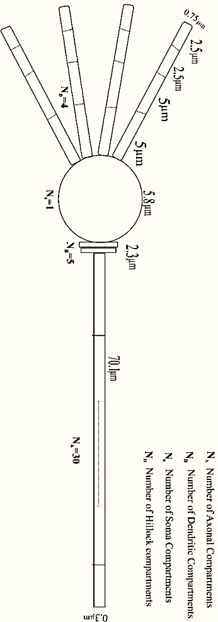
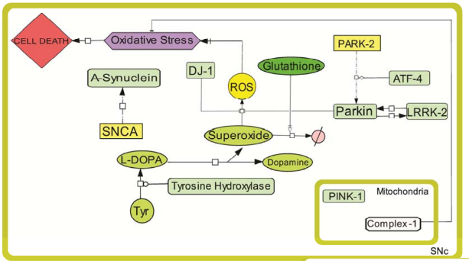
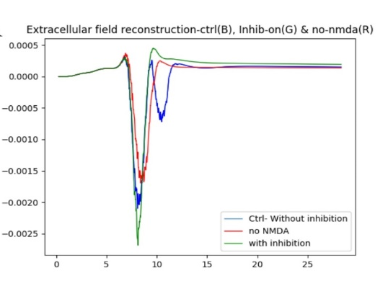
Multiscale Modeling
Biochemical Pathways
Single neuron model
Population model
Behavioral models

Slide 7

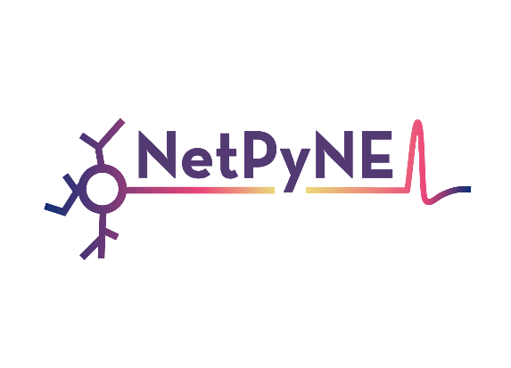

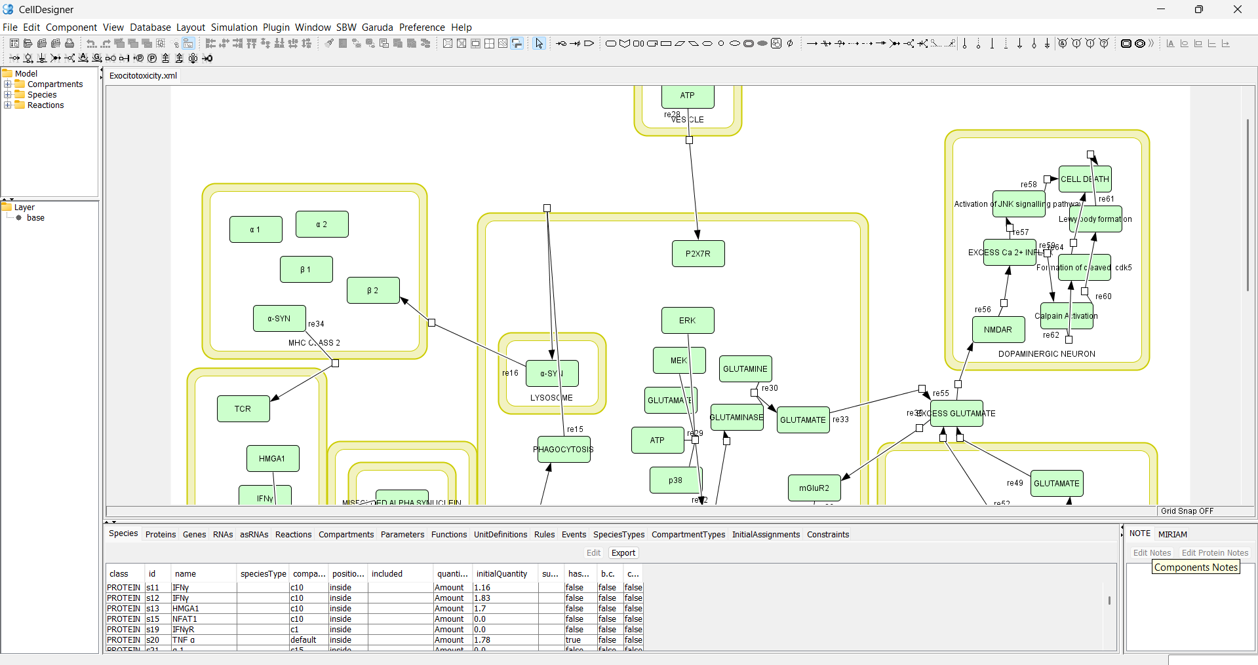
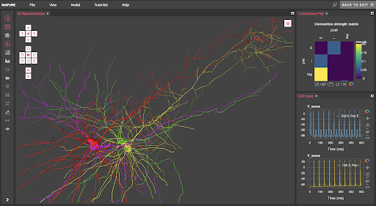
Multiscale Modeling Tools
Biochemical Pathways modelling tools
Neuron models

Slide 8
Introduction to Artificial Intelligence
Artificial Intelligence
Artificial Intelligence
Machine Learning
Neural Network
Deep Learning
NLP, Visual perception, Automatic reasoning, knowledge representation, Agents
Machine learning
SVM, Decision tree, Random forest, KNN, PCA, ICA, Regression
Neural Network
MLP, Feed forward networks, SOM
Deep learning
CNN, RNN, GAN, ResNet, Auto Encoder , Transformer networks​

Slide 9
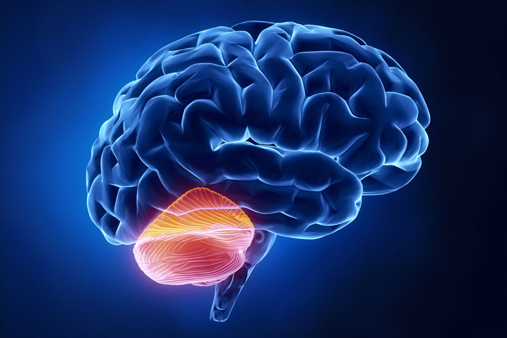
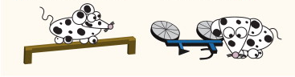
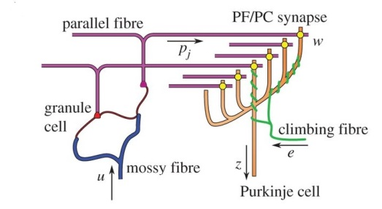
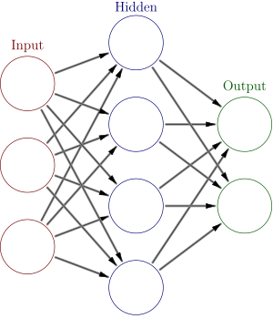
Supervised Learning Inspired from Brain
Motor Performance
Motor Error
Supervised Learning
Training data
Error
http://www.kidsintransitiontoschool.org/conozca-su-cerebelo-el-enlace-entre-movimiento-y-aprendizaje/
http://neuralalgorithms.group.shef.ac.uk/NARG/technical.php

Slide 10
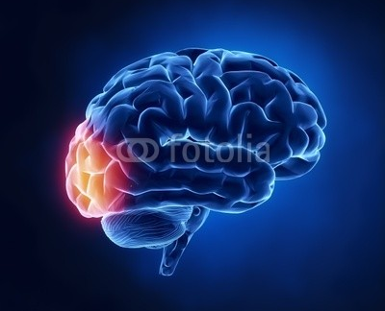
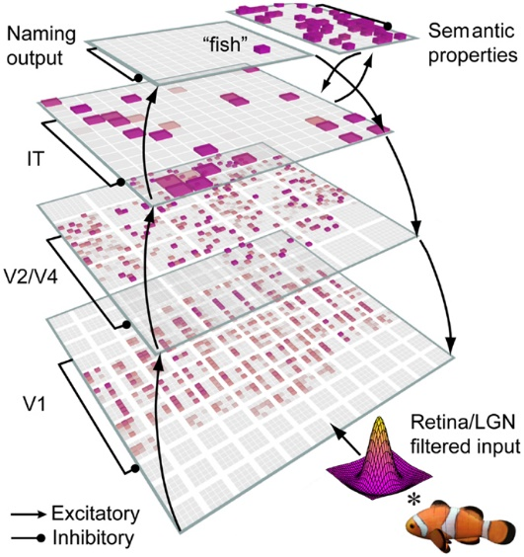
Unsupervised Learning Inspired from Brain
Unsupervised Learning
Input pattern
Output
http://journal.frontiersin.org/article/10.3389/fpsyg.2013.00124/full
http://neurosciencenews.com/tdcs-creativity-neuroscience-4048/

Slide 11
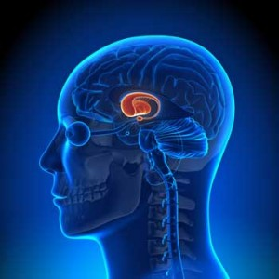
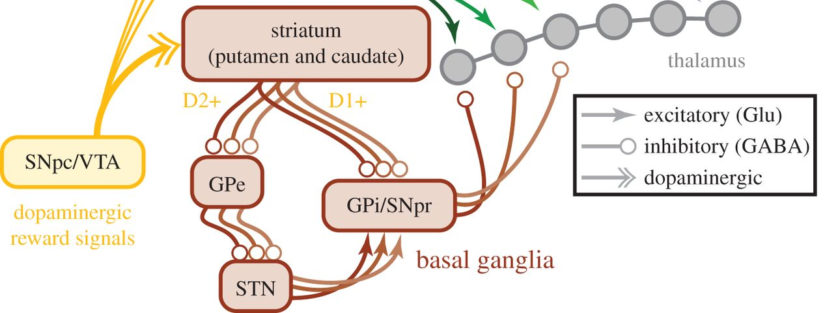
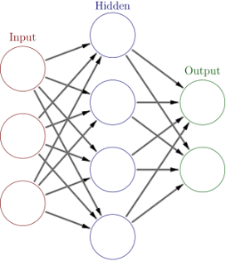
Reinforcement Learning Inspired from Brain
Reinforcement Learning
Training data
Critic
http://rstb.royalsocietypublishing.org/content/369/1655/20130471
https://www.healthrising.org/blog/2015/09/20/spinning-fibromyalgia-brain-findings-suggest-dopamine-may-be-key/

Slide 12
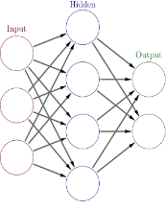
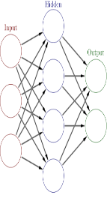
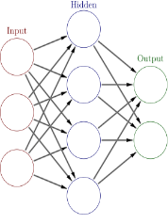
Machine Learning Inspired from Brain
Supervised Learning
Unsupervised Learning
Reinforcement Learning
Training data
Training data
Input pattern
Output
Error
Critic
http://neuralalgorithms.group.shef.ac.uk/NARG/technical.php
http://journal.frontiersin.org/article/10.3389/fpsyg.2013.00124/full
http://neurosciencenews.com/tdcs-creativity-neuroscience-4048/
http://rstb.royalsocietypublishing.org/content/369/1655/20130471
https://www.healthrising.org/blog/2015/09/20/spinning-fibromyalgia-brain-findings-suggest-dopamine-may-be-key/
http://www.kidsintransitiontoschool.org/conozca-su-cerebelo-el-enlace-entre-movimiento-y-aprendizaje/

Slide 13
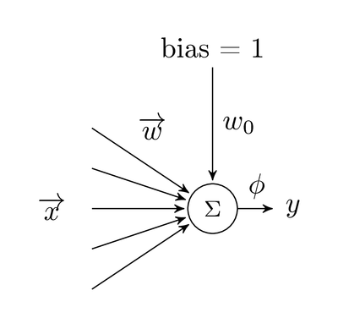
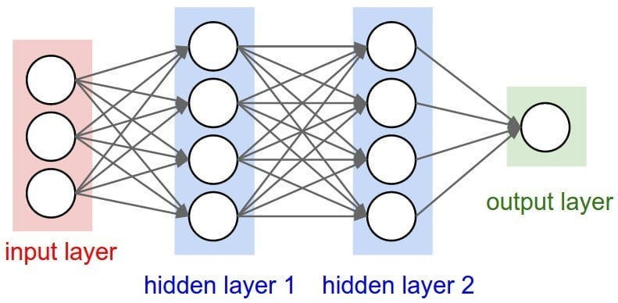
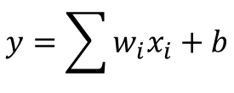
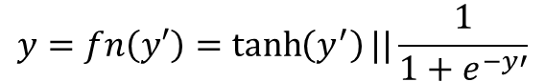
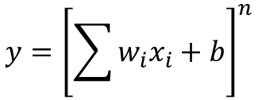
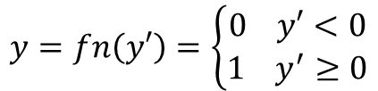
Neural Networks
First generation NN : Perceptron Model
$$y=fn\left(y′\right)=\left\{\begin{aligned}0 y′<0 \\ 1 y^{′}≥0\end{aligned}\right.$$
$$y=\sum{w_{i}x_{i}+b}$$
Heaviside function
Second generation NN : Artificial Neural Network Model
$$y={\left[\sum{w_{i}x_{i}+b}\right]}^{n}$$
$$y=fn\left(y′\right)=\tanh\left(y^{′}\right)||\frac{1}{1+e^{−y′}}$$
Logistic /hyperbolic tangent function
https://www.semanticscholar.org/paper/On-Line-Learning-with-Structural-Adaptation-in-a-N-Wysoski-Benuskov%C3%A1/053d5193baeba2cf1495f496e77d842c99c361fc

Slide 14
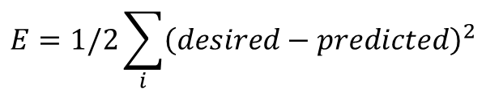
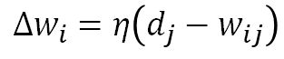
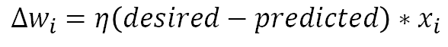
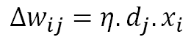
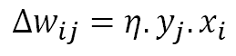
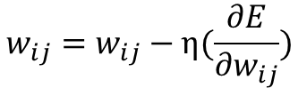
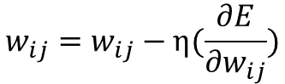
Learning rules
Hebbian Learning rule
Perceptron learning rule
Outstar learning rule
$$∆w_{ij}=η.y_{j}.x_{i}$$
$$∆w_{i}=η\left(desired−predicted\right)∗x_{i}$$
$$∆w_{i}=η\left(d_{j}−w_{ij}\right)$$
Correlation Learning rule
Delta rule
$$E=1/2\sum_{i}{{\left(desired−predicted\right)}^{2}}$$
$$∆w_{ij}=η.d_{j}.x_{i}$$
$$w_{ij}=w_{ij}−η(\frac{∂E}{∂w_{ij}})$$
Error Backpropagation
$$∆w_{i}=−η∇E=η\left[d_{i}−f\left(w_{i}^{t}x\right)\right]f^{′}\left(w_{i}^{t}x\right).x$$
$$w_{ij}=w_{ij}−η(\frac{∂E}{∂w_{ij}})$$

Slide 15
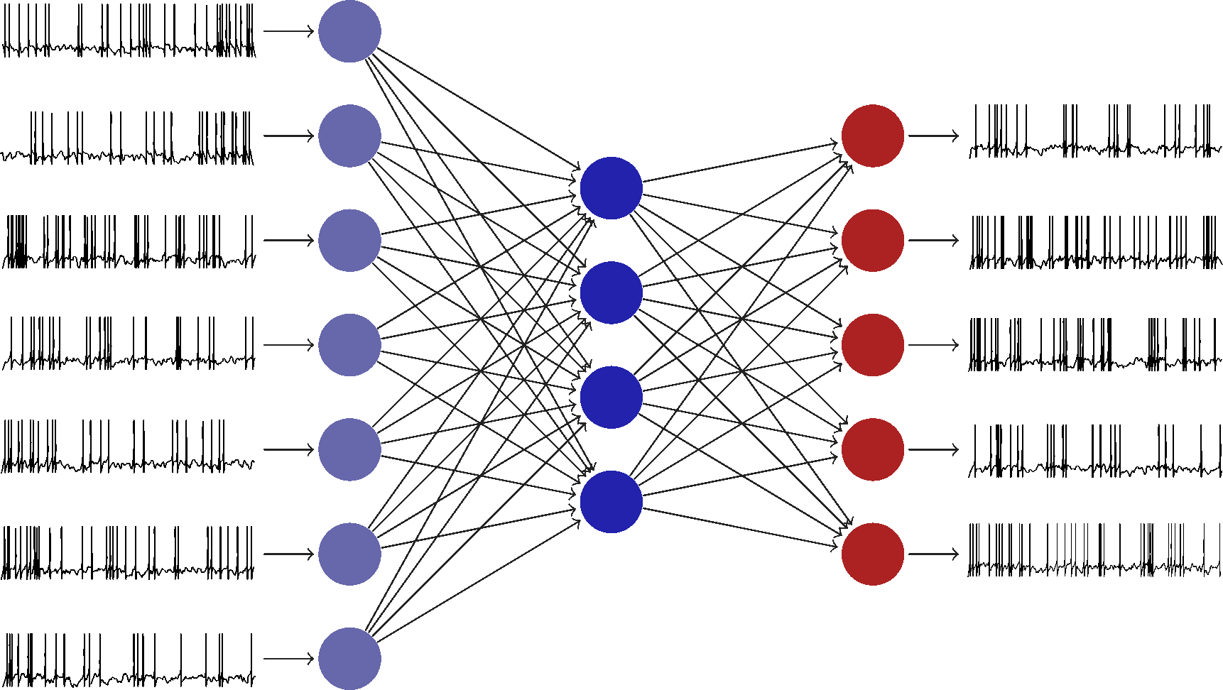
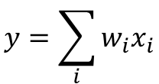




Spiking Neural Network
BCM learning rule
$$y=\sum_{i}{w_{i}x_{i}}$$
$${\frac{dw_{i}}{dt}=y\left(y−θ_{m}\right) x}_{i}−εw_{i}$$
$$θ_{m}=E\left[y/y_{0}\right]$$
STDP learning rule
$$∆w_{i}=\left\{\begin{aligned}+A_{+}\exp\left(−\frac{∆t}{τ_{pre}}\right) if∆t>0 \\ −A_{−}\exp\left(+\frac{∆t}{τ_{post}}\right) if∆t≤0\end{aligned}\right.$$
$$∆t=t_{post}−t_{pre}$$

Slide 16


Deep Learning Neural Network
CNN
Dense net
A fully connected network
With more hidden layers
Alzubaidi, L., Zhang, J., Humaidi, A.J. et al. Review of deep learning: concepts, CNN architectures, challenges, applications, future directions. J Big Data 8, 53 (2021). https://doi.org/10.1186/s40537-021-00444-8

Slide 17

AI in Brain Research: Key Applications

Slide 18


Neuroimaging & Diagnosis
AI for analyzing fMRI, CT, and EEG data Detecting brain diseases (e.g., Parkinson’s, Alzheimer’s, stroke)
Shang S, Shi Y, Zhang Y, Liu M, Zhang H, Wang P, Zhuang L. Artificial intelligence for brain disease diagnosis using electroencephalogram signals. J Zhejiang Univ Sci B. 2024 Oct 15;25(10):914-940. doi: 10.1631/jzus.B2400103. PMID: 39420525; PMCID: PMC11494159.
Xu M, Ouyang Y, Yuan Z. Deep Learning Aided Neuroimaging and Brain Regulation. Sensors (Basel). 2023 May 23;23(11):4993. doi: 10.3390/s23114993. PMID: 37299724; PMCID: PMC10255716.
18

Slide 19


Diagnosis and AI
19
Zhu G, Jiang B, Tong L, Xie Y, Zaharchuk G and Wintermark M (2019) Applications of Deep Learning to Neuro-Imaging Techniques. Front. Neurol. 10:869. doi: 10.3389/fneur.2019.00869
https://www.linkedin.com/posts/ai-echo_technology-future-creativity-activity-7302568482515169281-0uZq?utm_source=share&utm_medium=member_desktop&rcm=ACoAAAzzB7QBKIgLdvgFKA-HfmfuRLwRMrYUq1o

Slide 20



Brain-Computer Interfaces (BCI)
Mind-controlled prosthetics
AI-powered assistive technologies
https://www.linkedin.com/posts/drmarthaboeckenfeld_this-is-the-magic-of-technology-in-healthcare-activity-7296778279556964352-snjQ?utm_source=share&utm_medium=member_desktop&rcm=ACoAAAzzB7QBKIgLdvgFKA-HfmfuRLwRMrYUq1o
https://www.linkedin.com/posts/christoph-guger_just-testing-tms-stimulation-of-the-motor-ugcPost-7293561653915258880-b80P?utm_source=share&utm_medium=member_desktop&rcm=ACoAAAzzB7QBKIgLdvgFKA-HfmfuRLwRMrYUq1o

Slide 21



Neuro-Inspired AI
Spiking Neural Networks (SNN)
Brain-inspired computing

Slide 22

Neuro-Inspired AI
Zhang, W., Gao, B., Tang, J. et al. Neuro-inspired computing chips. Nat Electron 3, 371–382 (2020). https://doi.org/10.1038/s41928-020-0435-7

Slide 23

Cognitive Modeling & Simulation
Human-like decision-making models
AI models of brain computation, learning, and memory, built on experimental data from humans and animals,
https://www.sciencedirect.com/science/article/pii/S0889159123003380

Slide 24

Explainable AI (XAI) in brain research
Nicola Amoroso, Silvano Quarto,Marianna La Rocca,Sabina Tangaro,Alfonso Monaco,Roberto Bellott. An eXplainability Artificial Intelligence approach to brain connectivity in Alzheimer's disease. Front. Aging Neurosci. ,Sec. Alzheimer's Disease and Related Dementias, Volume 15, 2023. https://doi.org/10.3389/fnagi.2023.1238065

Slide 25
General questions on AI
Can AI replace consciousness or not?
Whether it is possible for AI to become “conscious” — or develop self-awareness similar to our human consciousness —
AI is a boon or bane ?
https://www.americanbrainfoundation.org/ai-and-the-brain/

Slide 26

Synergy between Brain and AI
https://www.microsoft.com/en-us/research/articles/towards-a-synergy-between-ai-and-the-brain-microsoft-research-asia-startrack-scholars-2025-explores-the-frontiers-of-ai-and-brain-science-with-you/

Slide 27

Challenges & Ethical Concerns
Citation: Naik N, Hameed BMZ, Shetty DK, Swain D, Shah M, Paul R, Aggarwal K, Ibrahim S, Patil V, Smriti K, Shetty S, Rai BP, Chlosta P and Somani BK (2022) Legal and Ethical Consideration in Artificial Intelligence in Healthcare: Who Takes Responsibility? Front. Surg. 9:862322. doi: 10.3389/fsurg.2022.862322

Slide 28



Now trending…..
AI makes non-invasive mind-reading possible by turning thoughts into text
“BrainGPT” , a non-invasive “mind-reading” app to decode brain signals into readable text using EEG
Translation accuracy score is about 40% (Sept 2024).
https://www.theguardian.com/technology/2023/may/01/ai-makes-non-invasive-mind-reading-possible-by-turning-thoughts-into-text
Large Language Model Extraction of PD-L1 Biomarker Testing Details From Electronic Health Records
Aaron B. Cohen, Blythe Adamson, Jonathan Kelly Larch, and Guy Amster
https://ai.meta.com/blog/brain-ai-research-human-communication/
28

Slide 29

AI at Amrita Mind Brain Center

Slide 30






Computational Neuroscience Research
Disease Networks: From Cells to Systems
Interconnected Motor Systems in Brain
Reconstructing Local Field Potential from realistic computational models for spontaneous and evoked stimuli
Sasidharakurup H, Diwakar, S. et al. 2017-2021
Rajendran A., Diwakar, S. et al. 2016- 2021
Parasuram H., Bodda S Diwakar, S. 2016

Slide 31




Computational Neuroscience Research
Computational Modeling of Neuro Vascular Coupling
Computational Modeling of fMRI BOLD responses from Neural Circuits
Radhakrishnan S. et al. 2019, 2020
Nutakki C. et al. 2016,2019

Slide 32







Brain-Computer Interfaces & Biomedical Devices
Cerebellum inspired spiking neural network for robotic abstraction
Experimental recording and assessment of human gait Using Mobile Phone Sensors and EEG
Biomechanical
Data Extraction
Left Hip
Left Ankle
Left knee
Vijayan &Diwakar, 2022
Low cost device development
Right knee
Right Hip
Right Ankle

Slide 33



Brain Computer Interface and Assistive Technology Using EEG
Yogic Visual Concentration (Trātaka) Assessment
Grasped movement and Analysis using EEG
Yoga and Meditation research
Understanding Music Ragas
Sandeep et al. 2017,2022

Slide 34







Education, Augmented reality and Virtual labs
Model of virtual labs in education
Augmented Reality

Slide 35



Society and Health
Diversity Studies – Surveys: Social and Neuropsychological assessments
Life Style and Health
Lifestyle Markers, Daily Life and Health Conditions
Using surveys and apps for data collection, analysis and assessment
Diwakar, S., (2023). Diversity and neocolonialism in Big Data research: Avoiding extractivism while struggling with paternalism.
Nutakki, C., Diwakar, S., (2023). Generalization and Personalization of Mobile Sensing-Based Mood Inference Models.

Slide 36





www.amrita.edu/mindbrain

